Slide 1
Notes:
Copyright 2023 Joseph Breeden

Slide 2
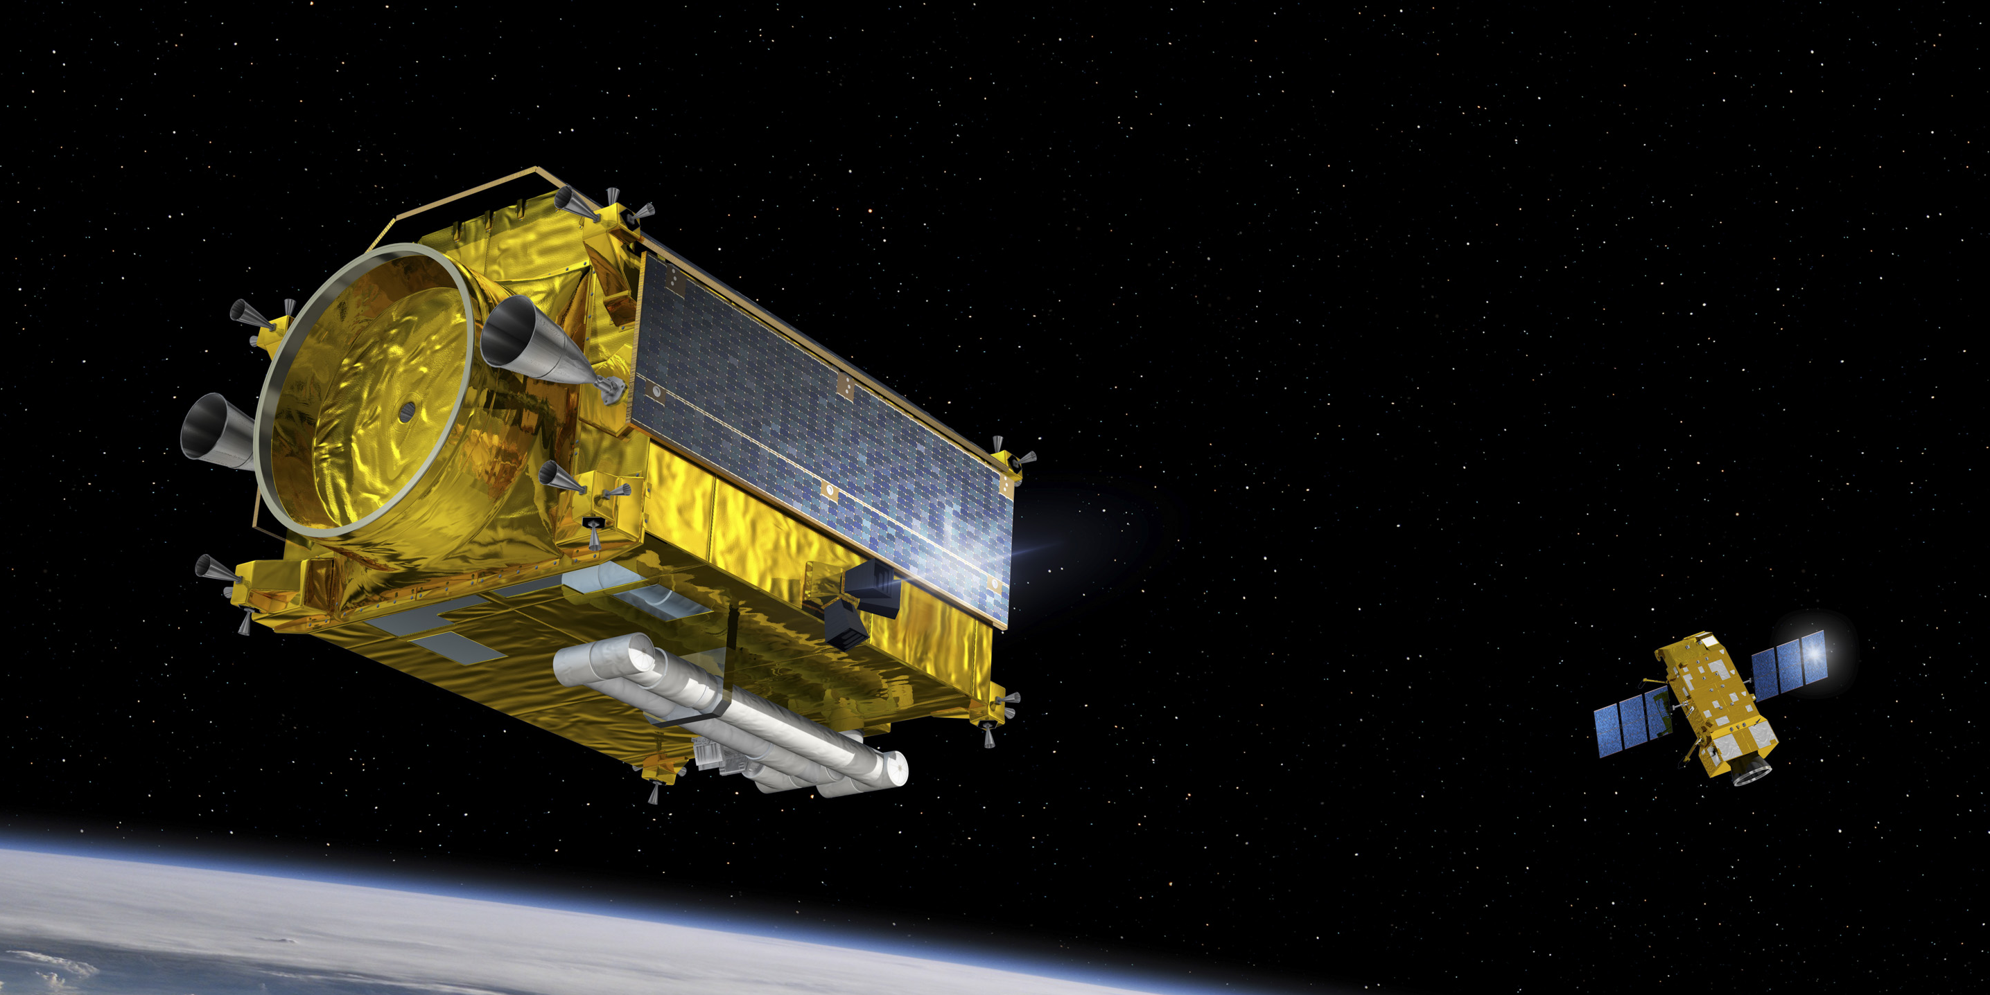
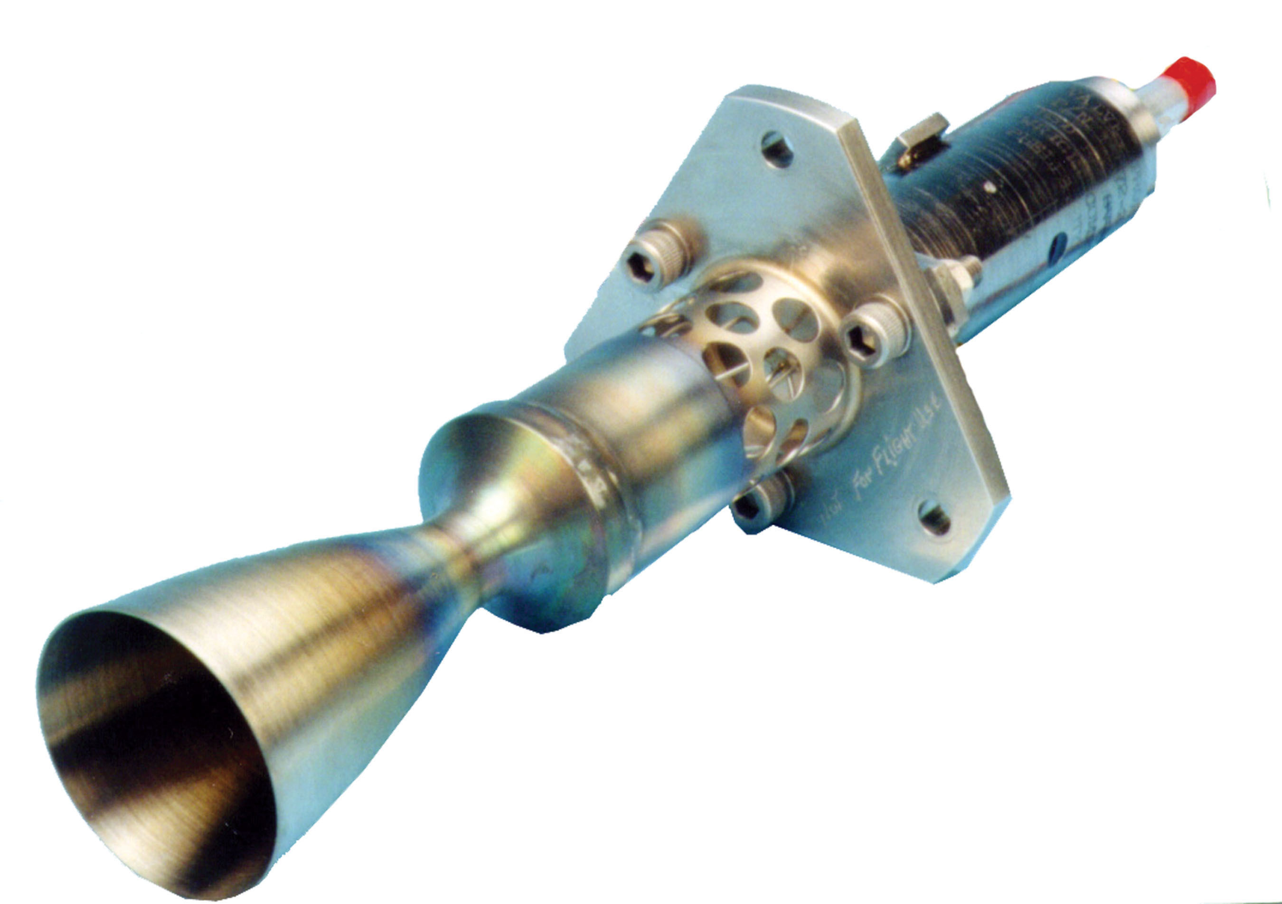
Objective
Credit: ESA
State constrained control for satellites
Problem setup
One controlled satellite needs to navigate in the vicinity of other objects in space
Control Barrier Functions (CBFs) are a promising solution
CBFs usually run in continuous time
Most satellites possess impulsive actuators
After an impulse, the satellite must wait a specified dwell time before the actuator can be used again
Also relevant to chemical/population systems
Credit: AMPAC-ISP

Slide 3
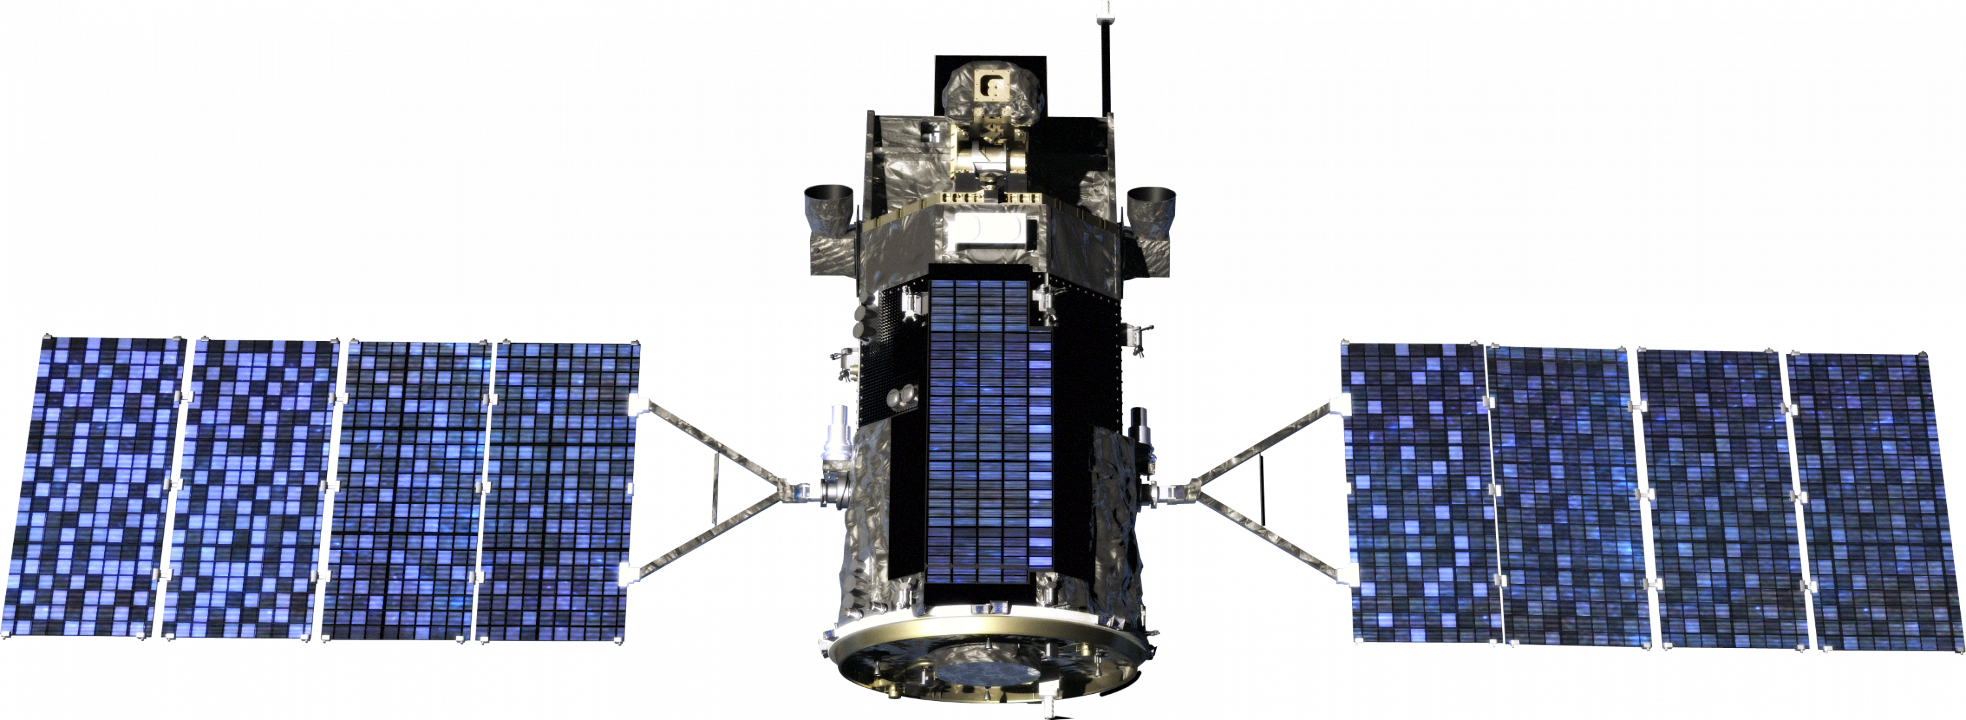
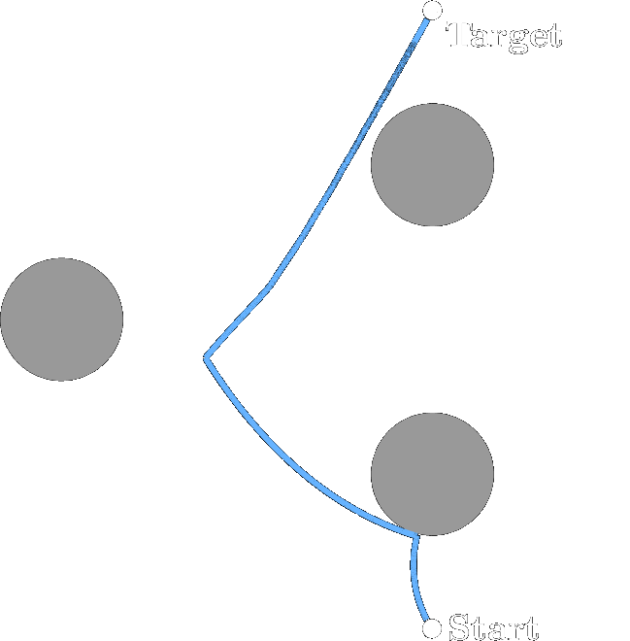
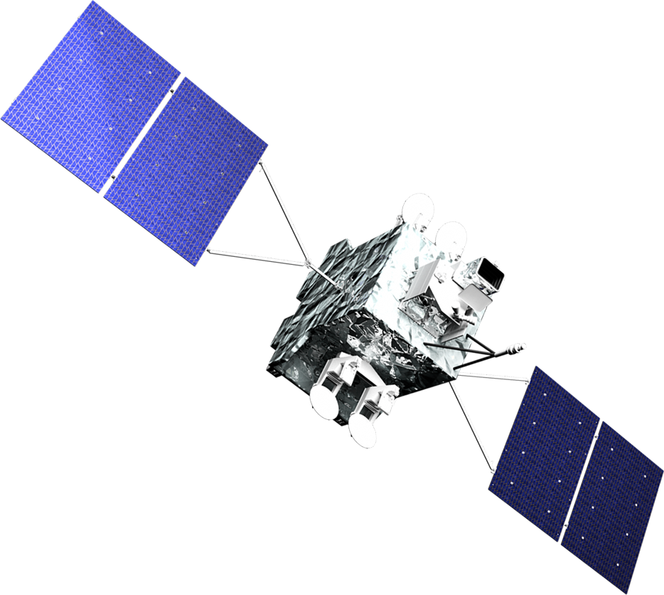
Objective
Safety
The controlled spacecraft avoids all other objects in its vicinity
Equivalently, the spacecraft stays within a specified safe set
Convergence
The controlled spacecraft reaches a target state
Both subject to the actuator dynamics
Real time instead of trajectory planning

Slide 4
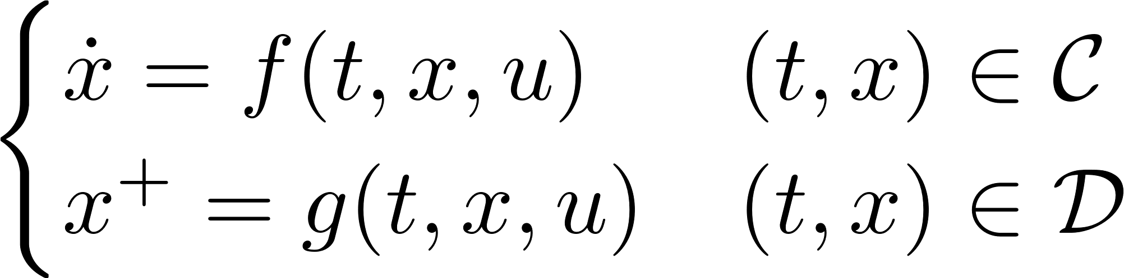
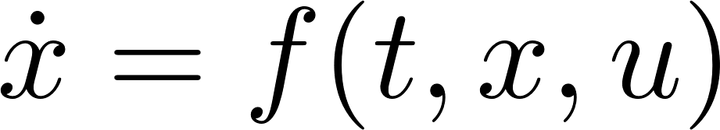
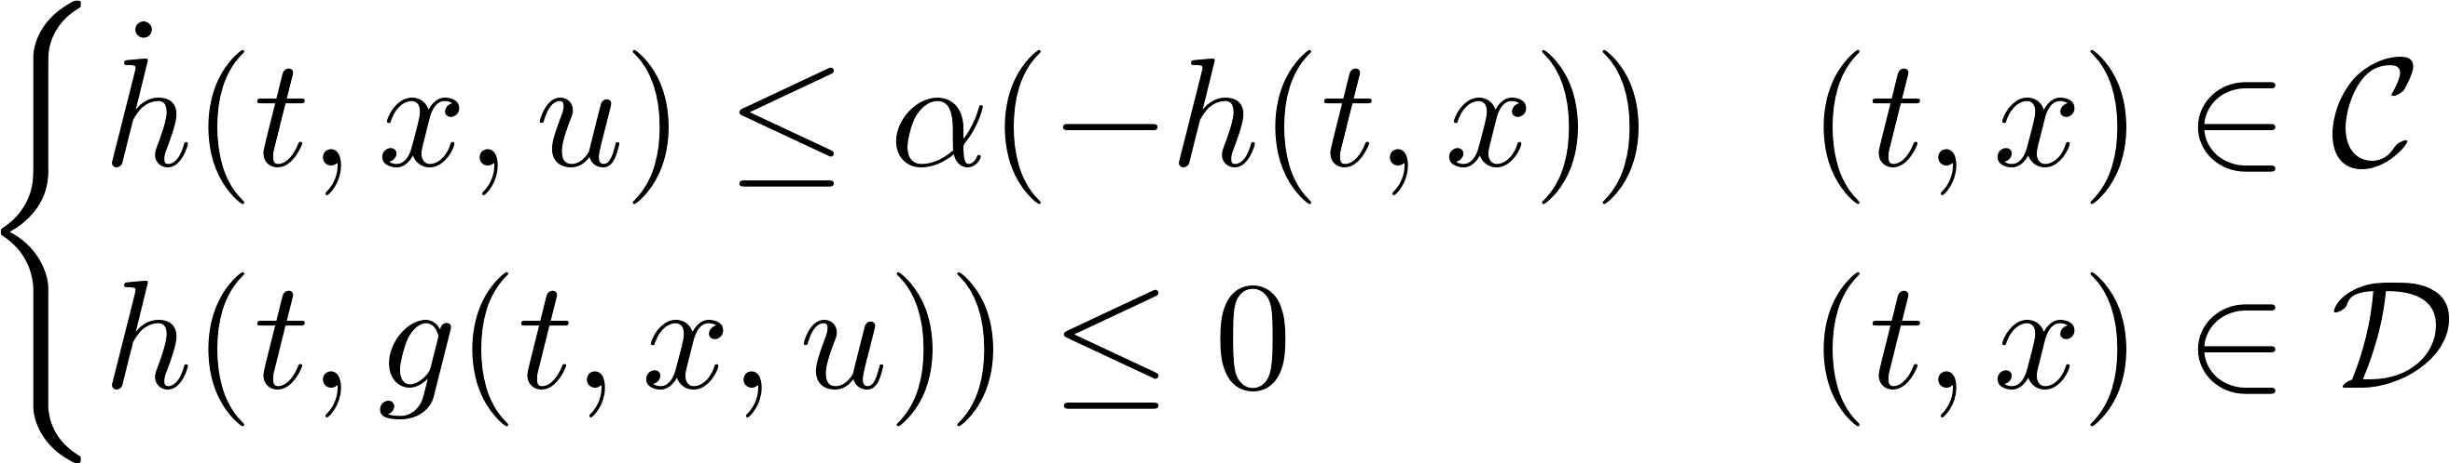
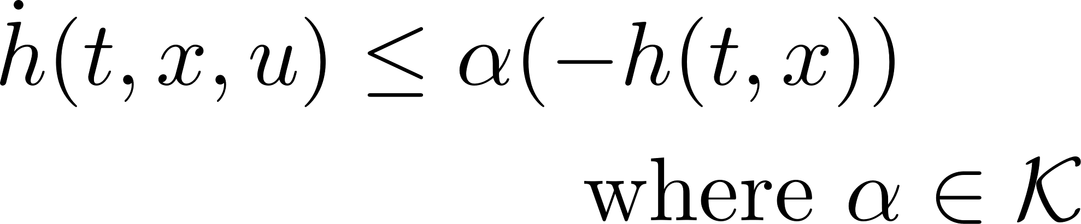


Introduction - Control Barrier Functions
[1] Chai and Sanfelice, “Forward invariance of sets for hybrid
dynamical systems (part ii),” TAC, 2021.
CBFs are a tool for set invariance
Assume that we already know how to pick
Continuous Time
Hybrid
is sufficient to render state trajectories always inside

Slide 5
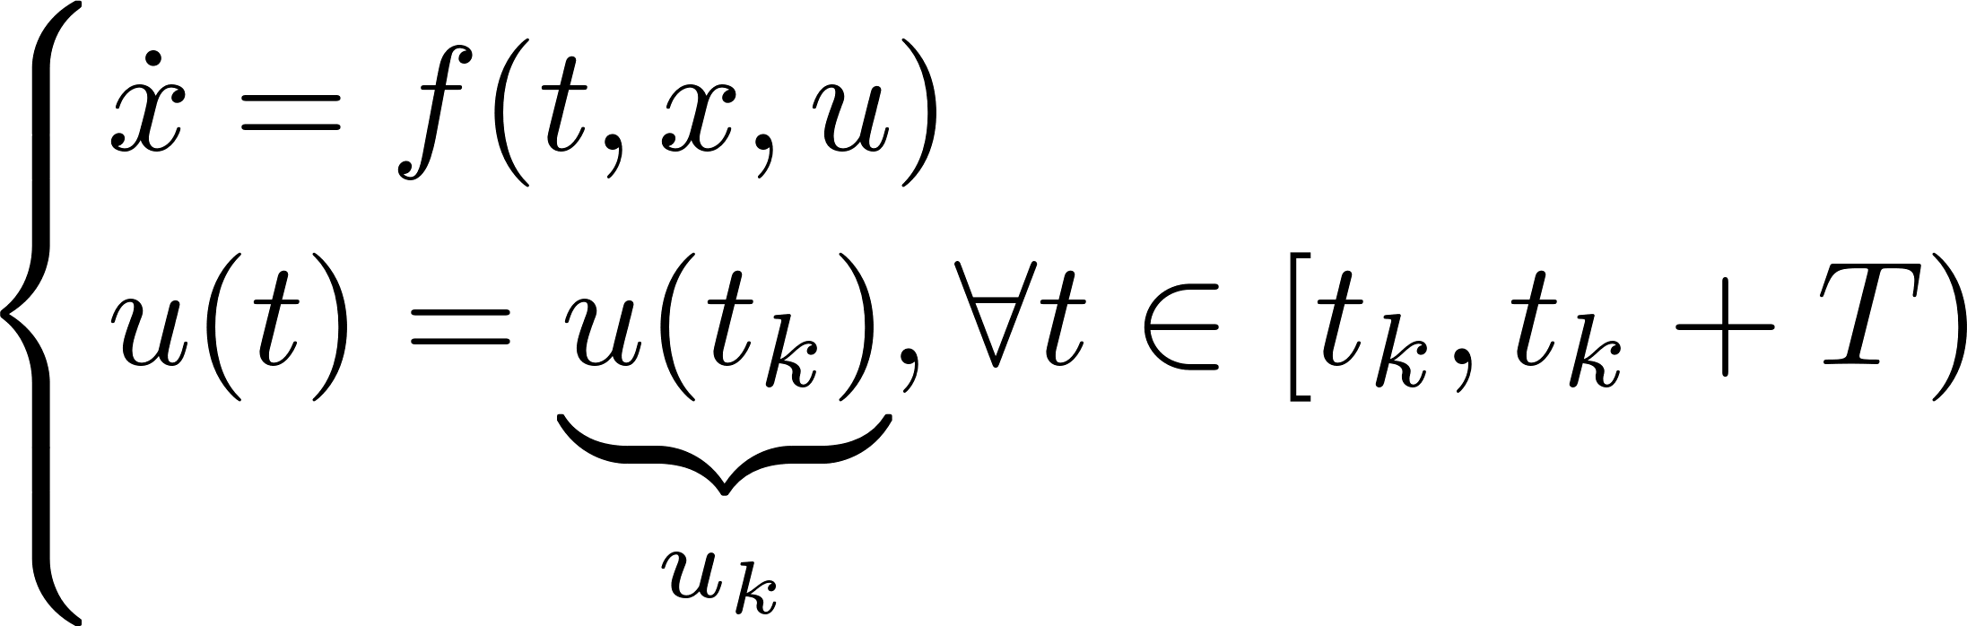

Introduction - Control Barrier Functions
Control Barrier Functions (CBFs) are a tool for set invariance
Continuous Time
Sampled-Data
where is a bound on higher order terms
[2] Breeden, Garg, and Panagou, “Control barrier functions in sampled-data systems,” LCSS, 2022.
[3] Shaw Cortez et al., “Control barrier functions for mechanical systems: Theory and application to robotic grasping,” TCST, 2019.
[4] Yang, Belta, and Tron, “Self-triggered control for safety critical systems using control barrier functions,” ACC, 2019.

Slide 6
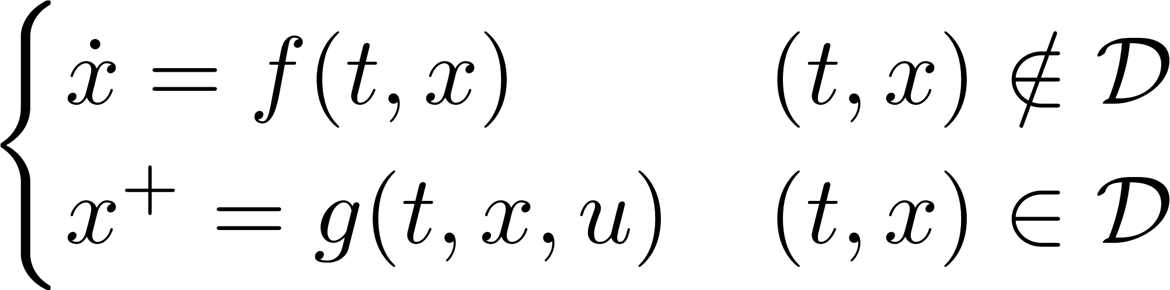
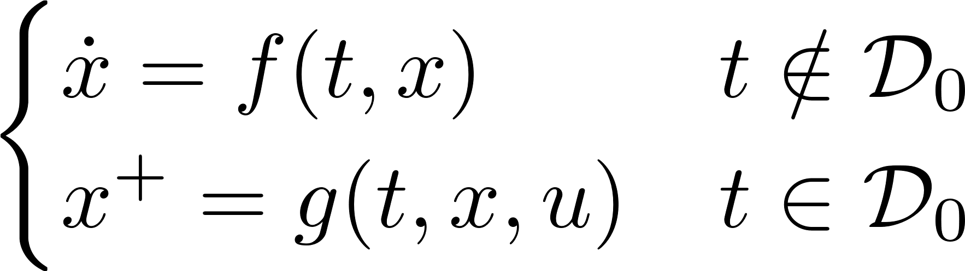
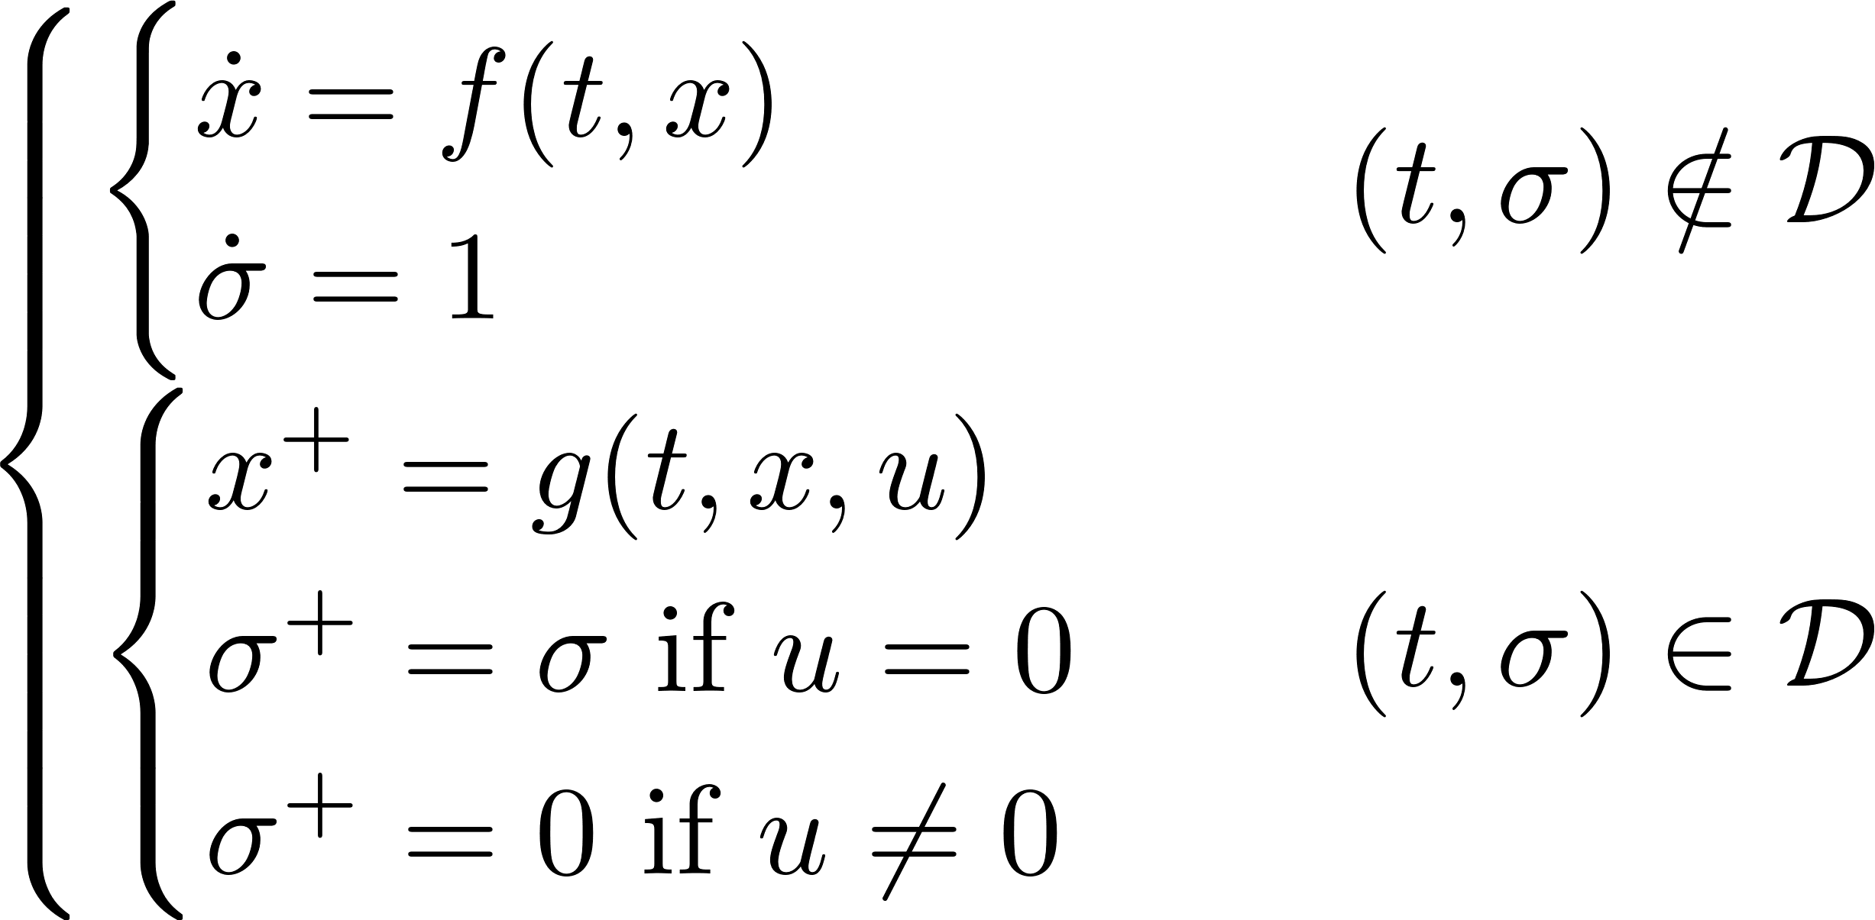
Impulsive System Definition
General hybrid system:
Rule 0: control is applied only via impulses and impulses only occur due to control
Rule 1: the controller is sampled with fixed period and an impulse can only be applied at the samples
Rule 2: the controller can only apply an impulse a minimum dwell time after the last impulse

Slide 7

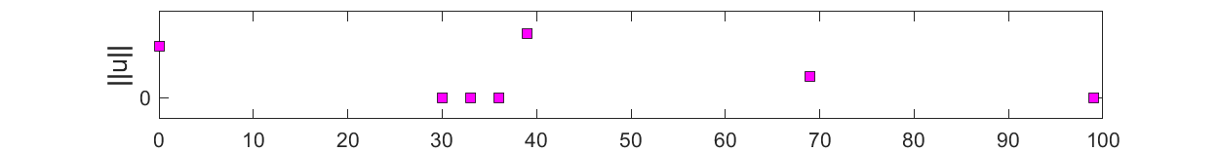
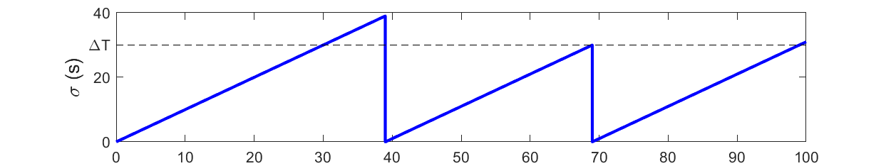
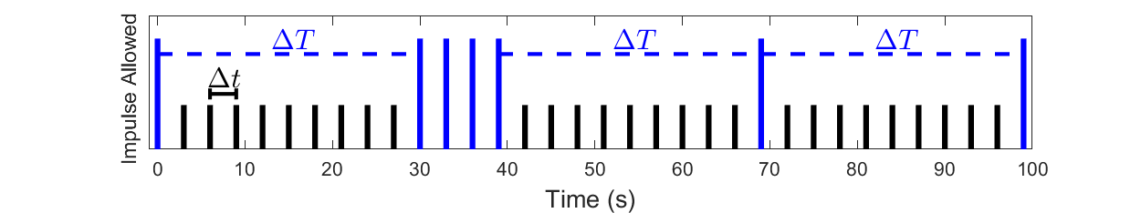
Impulsive System Definition
is the set of “impulse opportunities”

Slide 8



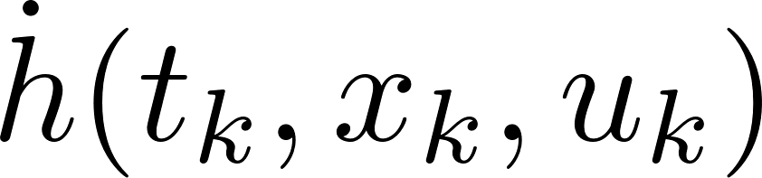
Method: Impulsive Timed Control Barrier Functions
Let denote the flow of the uncontrolled system
Let be an upper bound on over a horizon
For example, where is a bound on higher order terms
This was in the sampled-data example

Slide 9
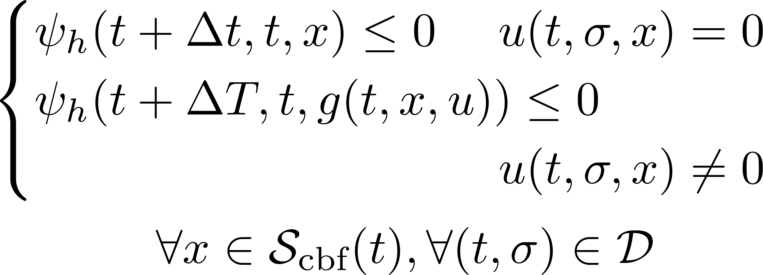
Method: Impulsive Timed Control Barrier Functions
Control Barrier Functions (CBFs) are a tool for set invariance
Continuous Time
Impulsive

Slide 10
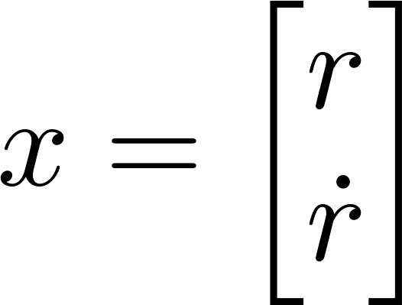

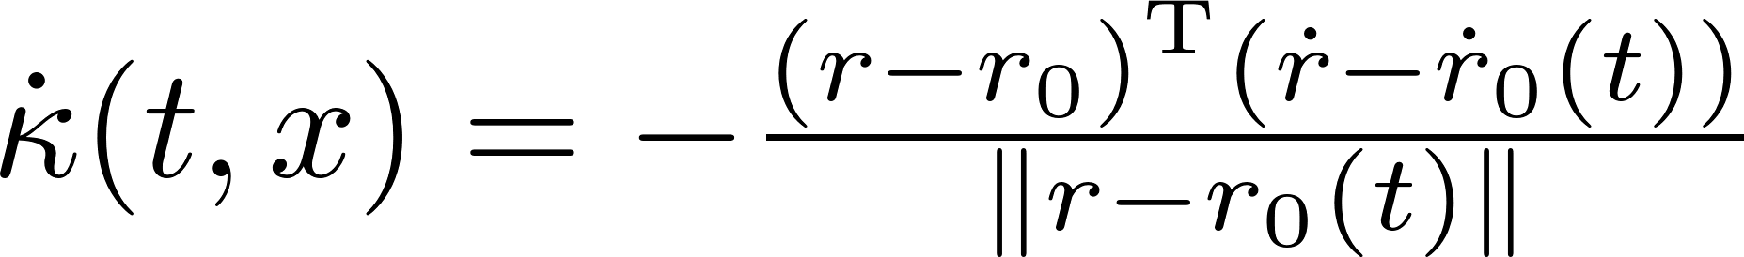

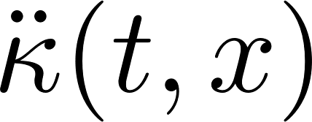

Applying ITCBFs
Suppose and is the set of states outside an obstacle
Choose where is affine in
One possible choice of upper bound is
See paper for details on related Lyapunov functions for convergence
upper bound on
[5] Nguyen and Sreenath, “Exponential control barrier functions for enforcing high relative-degree safety-critical constraints,” ACC, 2016
[6] Breeden and Panagou, “Autonomous spacecraft attitude reorientation using control barrier functions,” AIAA JGCD, 2023

Slide 11
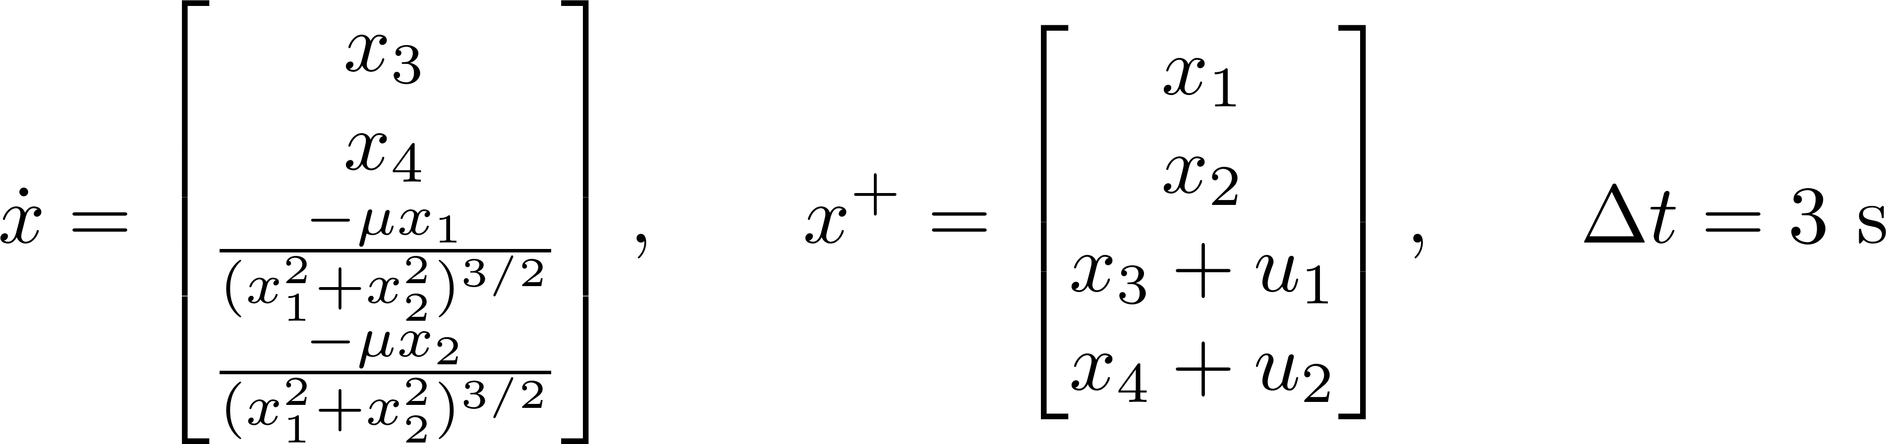
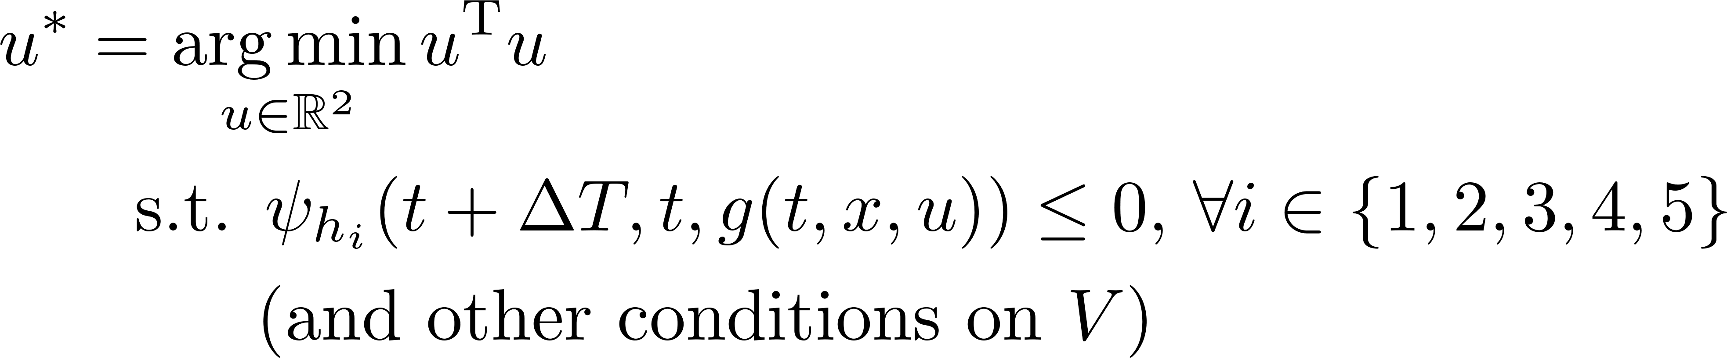
Applying ITCBFs
System
Control law is zero if zero is a safe choice
5 Obstacles = 5 ITCBFs
and otherwise is computed as the quadratic program
This condition is affine in u

Slide 12
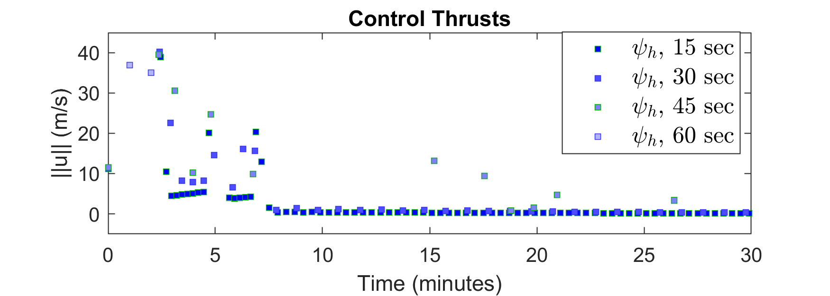
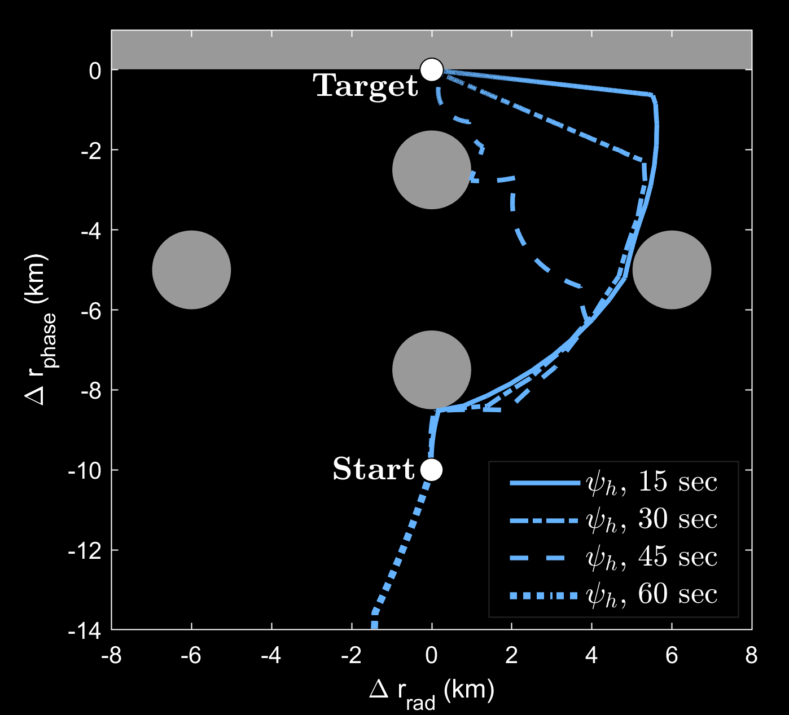
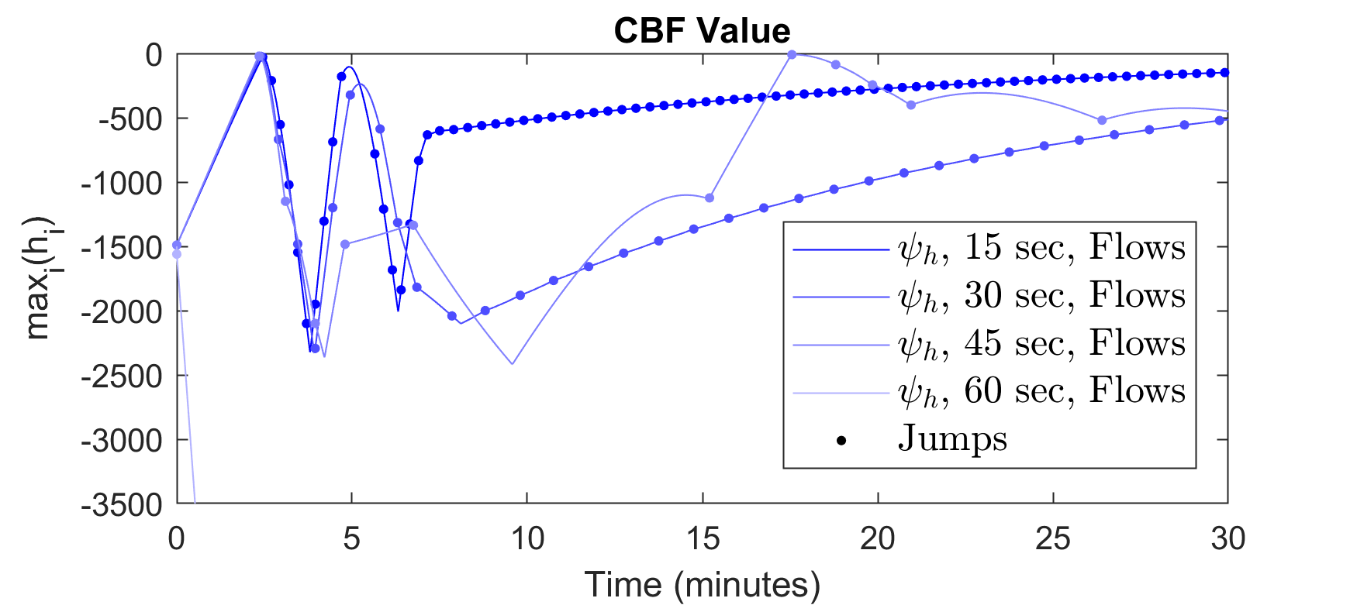
Simulation Part I
Results converted to Hill’s Frame for visualization

Slide 13
Simulation Part I
Results converted to Hill’s Frame for visualization
The strategy works up to 45 seconds of dwell time
At 60 seconds, the controller is so conservative that it turns away from the target
All trajectories used a lot of fuel (about 13x what a path planner achieved under the same constraints and time of convergence)

Slide 14
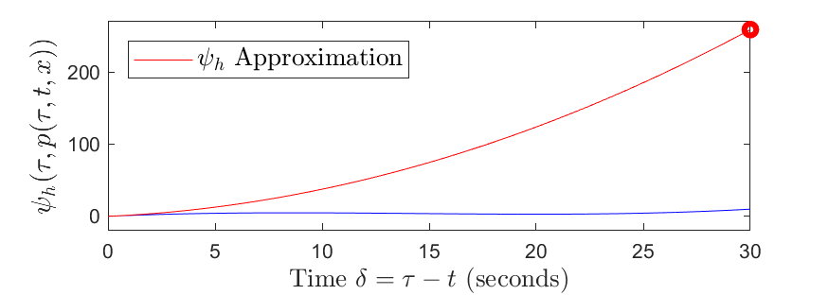


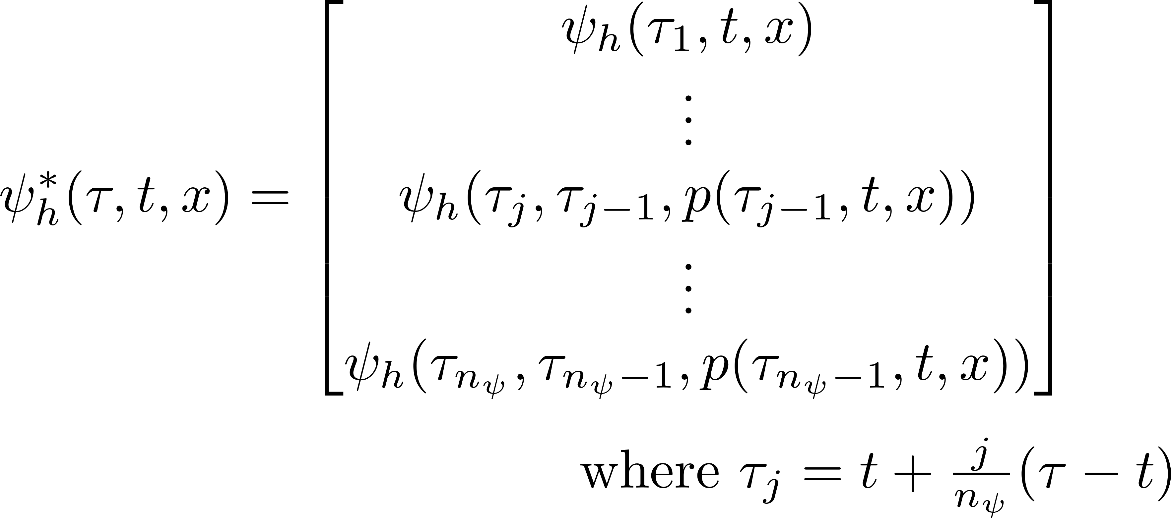
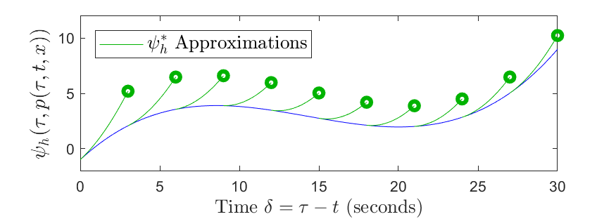
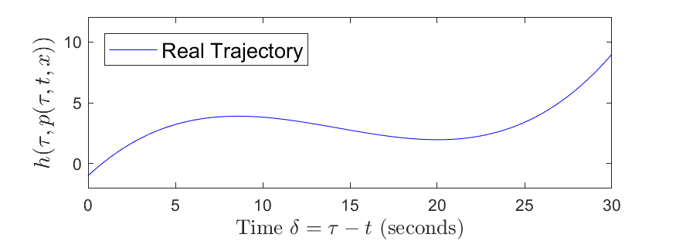

Extending ITCBFs
The conservatism of is quadratic in
Replace with predictions to reduce conservatism
Replace in the control law with the vector
Analogous to MPC with a control horizon of 1 and a long state horizon
The controller is now a nonlinear program instead of quadratic program
Assume that this is acceptable because of the long time between actuations

Slide 15

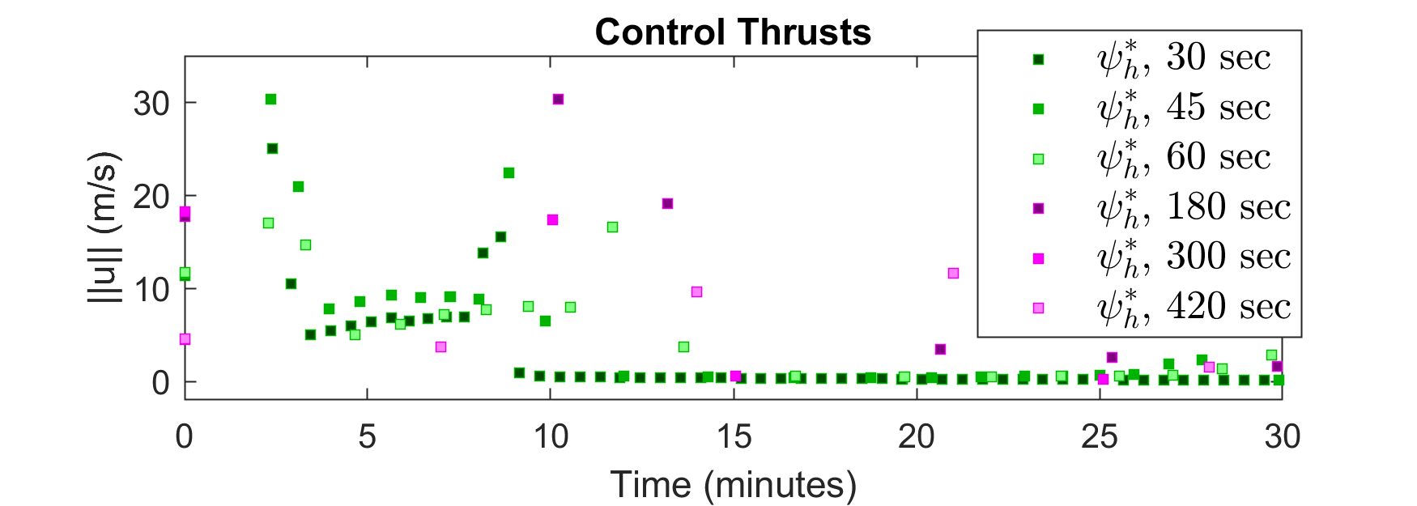
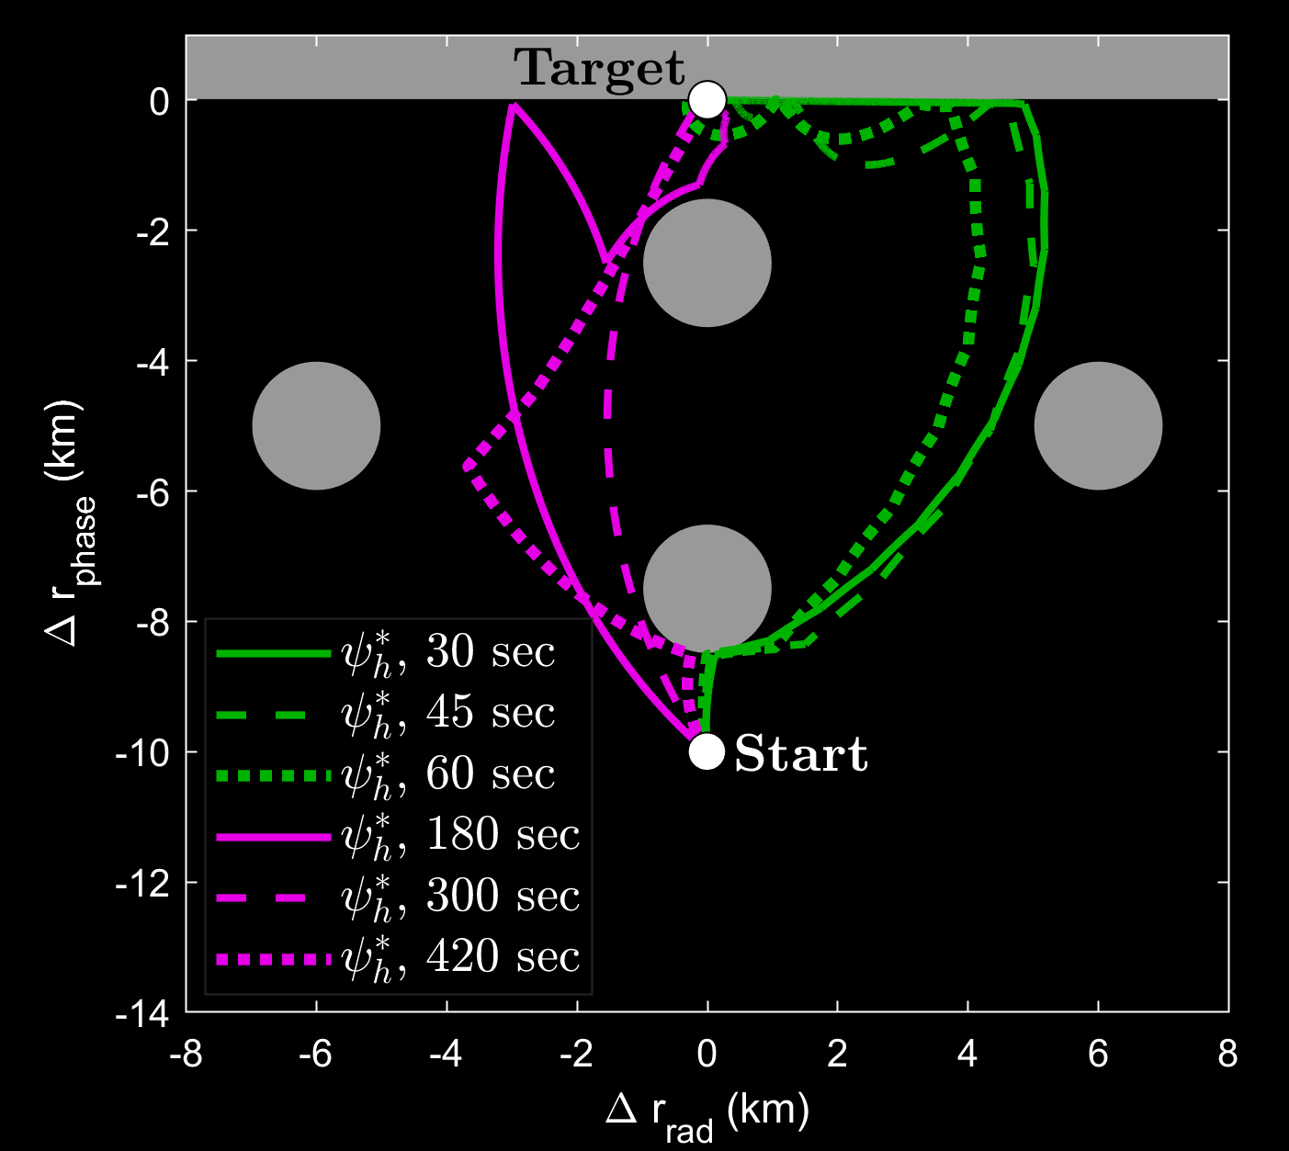
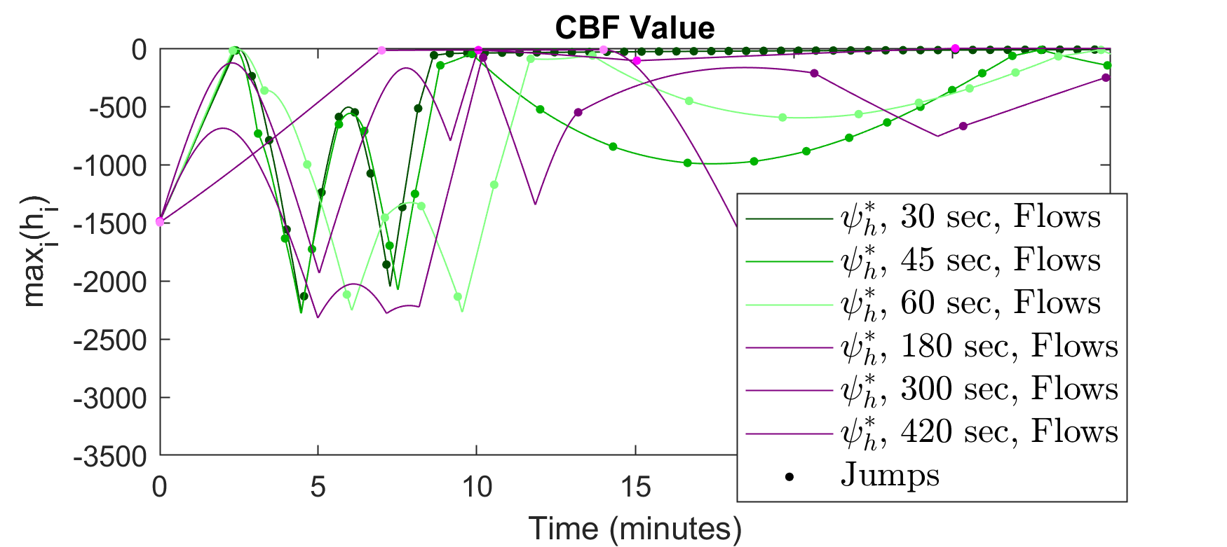
Simulation Part II
Let

Slide 16
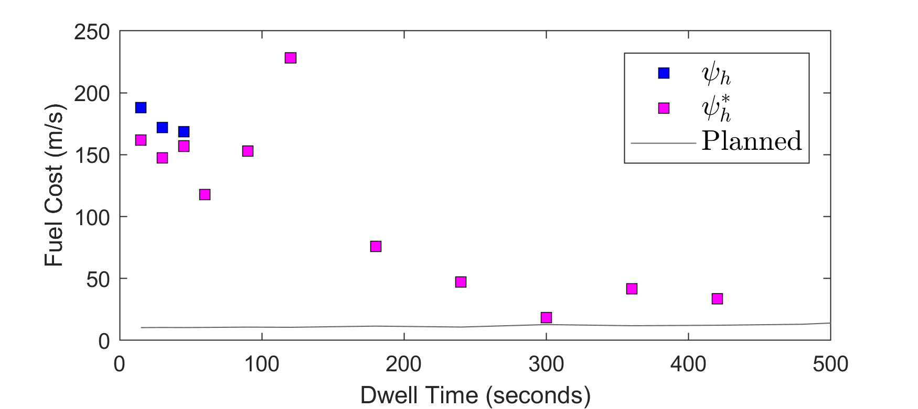

Simulation Part II
The strategy works up to at least 420 s dwell time for the choice
The strategy works for longer dwell times at but convergence is slow
Fuel consumption and time to convergence are nonlinear with dwell time
The lowest fuel trajectory (of those simulated) was , which took 1.4x as much fuel as the path planned trajectory

Slide 17
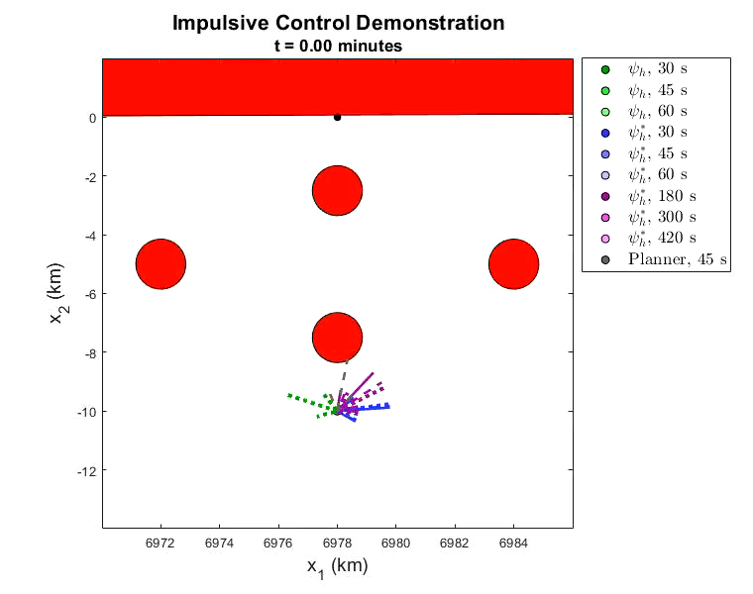
Animation

Slide 18
Conclusions
Extended CBFs to impulsive systems with minimum dwell time constraints
Impulses modeled as hybrid system but invariance conditions more similar to the sampled-data CBF literature
Larger dwell times generally reduce fuel consumption
Not a strict rule
Note that we did not set out to minimize fuel
We derived similar conditions for Lyapunov convergence in the paper
Future work
Consider robustness to disturbances that occur during and/or between impulses
Using this technique in conjunction with optimal control methods to minimize fuel

Slide 19


Thank You To Our Sponsors

